Slide 1


















HAND GESTURE-DRIVEN HOME AUTOMATION HUB
REG.NO :20BAI1049
: PHAROS SOPHY SAMUEL T J
: BHAVADHARINI R M
NAME GUIDE

Slide 2




PROBLEM STATEMENT
Controlling appliances through buttons and tangible devices has been the
traditional way.
This project aims at enhancing the human-computer interaction by using gestures controls the fan speed and brightness of a bulb & a led.
Given times where people might feel too lazy or tired to give voice commands, simple gestures or actions could make the communication process easier.
Moreover, such gesture based home automation greatly aids the speech impaired people to interact with smart devices at home, possibly.
Instead of taking a single picture, we record frames of the movement through cameras that detect the gestures delivered.

Slide 3


RESEARCH OBJECTIVE
Goal: Create a gesture-based home automation system which controls the
fan speed and brightness of a bulb & a led.
Technology: Uses computer vision & machine learning for hand gesture recognition.
Purpose: Control household appliances through recognized gestures. Aim: Innovate for user-friendly smart homes.
Benefits: Enhances convenience, accessibility, and efficiency in daily living.

Slide 4
PROPOSED SYSTEM – PROPOSED SYSTEM INTRODUCTION
"Home-based Automation Using Hand Gestures," leverages the Arduino Uno board
and the YOLOv5 algorithm for hand gesture recognition.
When showing one finger, the system turns on the fan at full speed. Using two fingers reduces the fan speed.
Three fingers activate two lights - an LED light and a bulb - with increased brightness.
Four fingers decrease the brightness of both lights, and finally, five fingers turn off the entire system.
The hardware components include the Arduino Uno, a small fan, an LED light, a bulb, an AC dimmer for light control, and a motor driver for the fan.

Slide 5

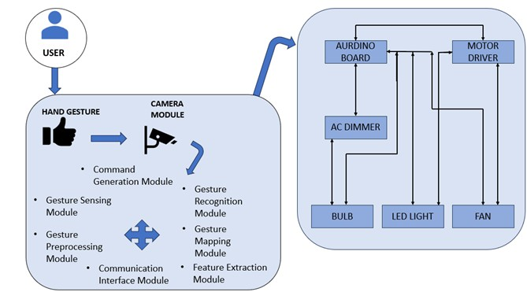
PROPOSED SYSTEM DIAGRAM

Slide 6
c) LIST OF MODULES
Gesture Sensing Module
Gesture Preprocessing Module Feature Extraction Module
Gesture Recognition Module Aurdino UNO
AC Dimmer Motor Driver

Slide 7
d) EXPLANATION OF ALL THE MODULES
Gesture Sensing Module:
Hardware: Camera is used as a device for capturing hand movements. Functionality: Captures real-time hand gestures within a defined space.
Gesture Preprocessing Module:
Functionality: Cleans and preprocesses raw gesture data, removing noise or irrelevant information.
Tasks: Filtering, noise reduction, background subtraction.

Slide 8
3. Feature Extraction Module:
Functionality: Extracts relevant recognition.
features from preprocessed gesture data for
Techniques: Histogram of Oriented Gradients (HOG) feature extraction methods.
4. Gesture Recognition Module:
Algorithms: Convolutional Neural Networks (CNNs) recognition models. Tasks: Interprets extracted features, recognizes specific hand gestures.

Slide 9
Gesture Mapping Module:
Functionality: Maps recognized gestures to predefined commands or actions. Tasks: Associating gestures with specific functions (e.g., turning lights on/off)
Communication Interface Module:
Protocols: Wi-Fi, Bluetooth, Zigbee, or other communication protocols.
Tasks: Facilitates data exchange between processing units and home automation devices.

Slide 10
TABULAR COLUMN
Module
Hand Gesture Recognition
Arduino Uno Fan Control Light Control
AC Dimmer Motor Driver System Control
Functionality
Utilizes YOLOv5 algorithm to recognize hand gestures
Acts as the central microcontroller, interpreting and executing commands based on hand gestures
Turns on the fan at full speed when one finger is detected; reduces the fan speed with two fingers
Activates two lights (LED and bulb) with higher brightness when three fingers are detected; reduces brightness with four fingers
Controls the brightness of the light bulb using AC dimming Regulates the speed of the fan by controlling the motor Shuts down the entire system when five fingers are detected

Slide 11
WHAT IS TO BE DONE NEXT
The implementation to be shown

Slide 12
RESEARCH PAPER STATUS
Resuts And Conclusion To Be Completed

Slide 13
Guide Approval Mail

Slide 14
References
https://www.ijraset.com/best-journal/finger-gesture-recognition-based-home-automation-using-iot
https://www.researchgate.net/publication/354046870_Vision_based_Hand_gesture_pattern_recognition_ena bled_home_automation_system_using_Internet_of_Things [3]https://www.sciencedirect.com/science/article/pii/S2772671123002619 [4]https://www.researchgate.net/publication/372984441_IOT_BASED_HOME_APPLICATIONS_CONTROLING
_USING_VISION_AND_GESTURE_THROUGH_RASPBERRY_PI
[5]https://www.researchgate.net/publication/359801928_Gestures_Controlled_Home_Automation_using_Deep_ Learning_A_Review [6]https://www.researchgate.net/publication/373923804_HAND_GESTURE_RECOGNITION_USING_RECURR ENT_NEURAL_NETWORKS_AND_SYNTHETIC_DATA_GENERATION
[7]https://www.researchgate.net/publication/373066982_Real-Time_Monocular_Skeleton- Based_Hand_Gesture_Recognition_Using_3D-Jointsformer

Slide 15
References
[8]https://www.researchgate.net/publication/371230969_Computer_Vision_based_Media_Control_using_Han
d_Gestures [9]https://www.researchgate.net/publication/353624643_Convolutional_neural_networks_framework_for_hum an_hand_gesture_recognition
[10]https://www.researchgate.net/publication/348308219_Improving_Real- Time_Hand_Gesture_Recognition_with_Semantic_Segmentation [11]https://www.researchgate.net/publication/352167439_Artificial_Intelligence_Based_Smart_Home_Automa tion_System_Using_Internet_of_Things#fullTextFileContent [12]https://www.researchgate.net/publication/374846019_Utilizing_ML_for_Hand_Gesture_Recognition [13]https://www.researchgate.net/publication/369488379_Gesture_Vocabularies_for_Hand_Gestures_for_Co ntrolling_Air_Conditioners_in_Home_and_Vehicle_Environments [14]https://www.researchgate.net/publication/374388028_HOME_AUTOMATION_SYSTEM [15]https://www.researchgate.net/publication/372339326_Hand_Gesture_and_Voice_Assistants

Slide 16


Thank You

